Slide 1

GameObjects and Gameplay
Course DNA
Summary:
GameObjects, components, dynamic instantiation/destruction, prefabs, finding references, vectors.

Slide 2
GameObjects and components
You are all aware now that a GameObject is anything that can be placed in a scene.
GameObjects contain a list of components that give them behaviours
Rigidbody allows the GameObject to work with the Physics system
Colliders allow for the detection of GameObjects hitting each other
a MeshRenderer draws a Mesh object to the screen
These (and many more) are in-built behaviours scripted by Unity’s own developers.
You can define your own custom behaviour for a GameObject by making a new class and adding it as a component onto a GameObject.
We did this when we made a new class (called Tilt) to handle the tilting action for our board.

Slide 3
Dynamic instantiation
This is fine if a GameObject is already in the scene. We just drag and drop the new component onto it in our scene.
Not all GameObjects will exist in the scene though before the game is run.
GameObjects such as bullets are only created when a action/event occurs, such as when a weapon is fired.
To handle this, there are two ways to dynamically create a GameObject
Instantiation (from a referenced GameObject)
Prefab loading (from a stored GameObject which is then instantiated)

Slide 4
GameObject instantiation
To dynamically create a GameObject, you use the Instantiate method.
public class Bazooka : MonoBehaviour
{
public int ammo;
public GameObject projectilePrefab;
public void fire()
{
Instantiate(projectilePrefab, transform.position, transform.rotation);
ammo--;
}
}
This method actually returns an Object (note: you can cast this to a GameObject)
GameObject proj = Instantiate(projectilePrefab, transform.position, transform.rotation);
Proj.DoSomething();

Slide 5
Prefab loading
An alternative to using Instantiate is to load a prefab at runtime which is then instantiated for you.
This effectively duplicates a pre-built GameObject.
In order for this to work, a prefab must have been built and placed in a Resources folder within the project. Note: you can have multiple Resources folders in your project.
public class Bazooka : MonoBehaviour
{
public int ammo;
public void fire()
{
GameObject go = Resources.Load("Projectile") as GameObject;
Instantiate(go);
ammo--;
}
}
This path is relative to a Resources folder in your Assets folder. Note: you can have more than one Resources folder in a project.

Slide 6
Dynamic destruction
We may also want to be able to destroy GameObjects dynamically.
You can use the method Destroy on a GameObject to do this.
There is another method called DestroyImmediate but its use is not recommended.
public class Projectile : MonoBehaviour
{
void OnCollisionEnter(Collider other)
{
Destroy(this);
}
}
What does the keyword 'this' mean as used here?
It refers to the object that this script is attached to (the projectile GameObject in this case).
Note: you can use Destroy with GameObjects, Components and assets.
Notes:
DestroyImmediate should ONLY be used when writing editor code since the delayed destruction will never be invoked in edit mode. In game code you should use Object.Destroy instead. Destroy is always delayed (but executed within the same frame). Use this function with care since it can destroy assets permanently! Also note that you should never iterate through arrays and destroy the elements you are iterating over. This will cause serious problems

Slide 7
Dynamic destruction
If you check the documentation for Destroy, you will also find that it can take an optional second parameter.
This parameter is a float value that can be used to delay the actual destruction by an amount of time (in seconds).
public class Projectile : MonoBehaviour
{
public float delay;
void OnCollisionEnter(Collider other)
{
Destroy(this, delay);
}
}

Slide 8
Complex GameObject behaviour
Each component attached to a GameObject adds some form of behaviour to it.
How much behaviour should go into one component?
Enough to make the component do one useful fully encapsulated behaviour that can potentially be reused on other GameObjects in this and maybe other projects.
This is called modularity.
To make GameObjects do complex things such as a fully animated 3D 3rd person controlled character that has an inventory, stats, quest log etc. you need components creating and attaching for each of these behaviours.
Let's start with a simple example for our Tilting Board.

Slide 9
Colour-coded door
We want to start looking at adding more gameplay into our prototypes.
We saw last week how easy it was to create a teleport to move the ball to another part of the board.
We used a cube as our trigger and attached a simple script to it which used the OnTriggerEnter method to change the ball’s transform position to that of another GameObject.
What if we want to create doors that open only when the ball is a particular colour?
How would we approach this in Unity?
What do we need to know?

Slide 10
Script requirements
A script to open and close a door.
Something to store the colour the door will open on.
Which object will cause the door to open.
Something to store that object’s current colour.
Something to change the colour of the ball.
What classes do we have to make?
One class for the door.
To store the opening colour and door opening functionality
One class for the ball?
so we can keep and update its current colour
One class for the ball colour changer script.
we can use this in for the colour-coded check within trigger volumes

Slide 11
Useful things
We’ve said before that classes define behaviours (data members and methods for manipulating them).
In OO, we normally create an object from a class (using the 'new' keyword) and store that somewhere for our use.
In Unity, when you attach a class as a component of a GameObject, you are instantiating an object of your class and adding it to the component list of the GameObject.
So, we may create a door class and drag-and-drop it onto a suitable GameObject (like a flattened cube) in our scene.

Slide 12
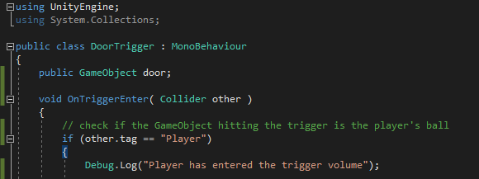
A simple door script

Slide 13
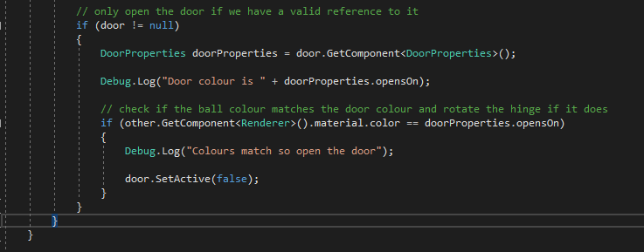
A simple door script

Slide 14
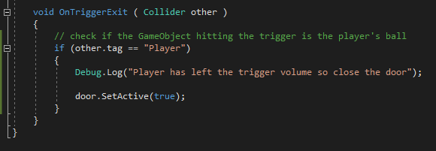
A simple door script

Slide 15
Unity and the Color class
There are two ways of creating a colour object in Unity.
Both are quite similar and take values between 0.0 and 1.0.
One uses RBGA and the other uses RGB components.
Color myColor = new Color(r, g, b, a);
Color myColor = new Color(r, g, b);
http://docs.unity3d.com/Documentation/ScriptReference/Color-ctor.html
E.g. to make yellow:
Color myColor = new Color(0.0f, 1.0f, 1.0f);
Note that some colours are predefined e.g. Color.yellow

Slide 16
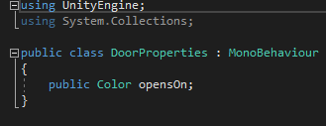
Adding a colour data member

Slide 17
Accessing GameObjects in the scene
There are several useful functions you can use in Unity to access objects (and their components) in your scripts.
GameObject.Find("MyName");
GameObject.FindWithTag("MyTag");
GameObject.FindGameObjectsWithTag("MyTag");
Note: you should not execute any of these accessors every update for performance reasons!!!
For one thing, the chances are that the reference never or rarely changes once it is set.
Also, searching is a time-consuming activity for a computer.
There are many schemes for improving search times but none are simple.

Slide 18
Accessing GameObjects in the scene
You should store a reference (basically a pointer) to these in your class and assign the GameObject to it in the Awake method:
private GameObject go;
void Awake()
{
go = GameObject.Find("MyName");
}

Slide 19
Using Find and FindWithTag
// using Find (this goes inside a method)
GameObject myObject = GameObject.Find("MyName");
// using FindWithTag (this goes inside a method)
GameObject myObject2 = GameObject.FindWithTag("MyTag");

Slide 20
Using FindGameObjectsWithTag
GameObject [] myObjects;
myObjects = GameObject.FindGameObjectsWithTag("MyTag");
foreach (GameObject obj in myObjects)
{
Debug.Log("Object has name: " + obj.name);
}
This is an example of an alternative form of the FOR loop that we saw last week.
It is easier to use but will only work on data structures defined in the .NET Collections Framework.
Basically, these data structures have what is called an iterator as part of their specification.
You can also make your own data structures that support an iterator and can therefore use the FOREACH loop with those as well.
You should note that the FOREACH loop is generally a bit slower than a normal FOR loop.

Slide 21
Finding a child GameObject
If you want to get an object that is the child of another object, there are several approaches you can take.
If it is uniquely named in the scene then just use a call to GameObject.Find
If there are several GameObjects in the scene, each of which has a child GameObject with the same name (e.g. Weapon), then what?
If you already have the object reference to the parent GameObject, then you can still use Find but this time you do it with the transform of the parent object.
GameObject go = GameObject.Find("Parent");
go.transform.Find("Child");
We can do this because, if you recall from last week, a Transform component holds all of the information about any child GameObjects attached to it.

Slide 22
Accessing components
In a game, being able to access (or get a reference to) another GameObject is obviously useful (OO depends upon this principle).
Since Unity is a component-based architecture, you also need to be able to access a GameObject’s components to be able to use, change, add or remove them.
To get a reference to a component, you use the GetComponent method on a GameObject (or component).
public GameObject myObject;
public Rigidbody objRB;
objRB = myObject.GetComponent<Rigidbody>();
MyClass myComp = myObject.GetComponent<MyClass>();
myComp.SomePublicMethod();
myComp.somePublicData = someValue;

Slide 23
Using Find and GetComponent
It is common (but dangerous) to see Find and GetComponent used together. E.g.
MyClass myComp = GameObject.Find("Player").GetComponent<MyClass>();
// call a public method in an object named door // created/instantiated from the DoorProperties class
door.SomePublicMethod();
// access a public data member called opensOn in an object named // door created/instantiated from the DoorProperties class
Color doorColour = door.opensOn
// assign a value to a public data member called opensOn in an // object named door instantiated from the DoorProperties class
door.opensOn = new Color(1.0f, 0.0f, 1.0f);

Slide 24
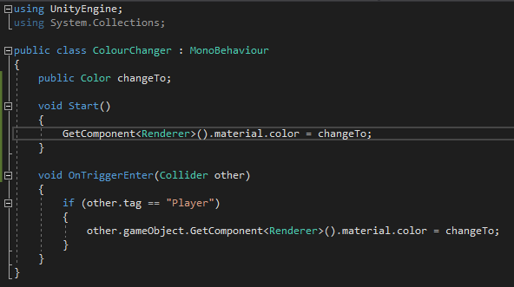
Making our colour changing trigger

Slide 25
Empty GameObjects
It may seem a bit bizarre but there are many times when putting an empty GameObject into the game world (the scene/level) is useful.
Strictly speaking, an empty GameObject isn’t empty.
All GameObjects have a Transform component.
One common use for an empty GameObject is to help you organise a long list of GameObjects in the scene hierarchy.
If you have many different types of GameObjects (and lots of them) then you can make an empty GameObject for each type and then parent appropriate GameObjects to them.
Basically, you treat the empty GameObject like a folder.
If you do this, never manipulate the empty GameObject’s transform (unless you really want to).
You can set the parent for a GameObject in either of the following ways:
transform.parent = someGameObject.transform;
transform.SetParent(parentTransform);

Slide 26
Vectors
A vector is a mathematical construct.
It defines a magnitude and a direction.
If I was to ask you to drive at 40mph, that only describes how fast I want you to drive.
This is known as a scalar value in maths.
If I tell you to drive at 40mph due north then this also gives you a direction to travel in.
This is a vector value.
The key point is that to follow my instructions, you must know how fast is 40mph and which way north is.
This brings us to the concept of a grid.
A grid defines a set of axes.
Divisions of these axes then help us to construct the grid itself using intersections.
These intersections define a series of co-ordinates.

Slide 27
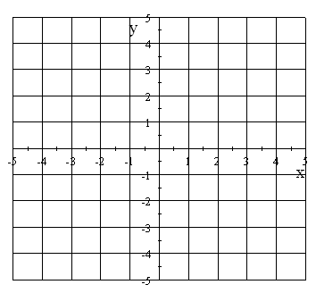
2D grid
Here’s the standard 2D grid you are familiar with:

Slide 28


An example 2D vector
v
We can describe this vector using the axes defined: v = (2,4)
This is two units along the x-axis and four units along the y-axis.
This also describes the vector’s direction.
To get its magnitude, we have to use a bit of Pythagoras:
Therefore: mag = √20 ≈ 4.472
$$a^{2}+b^{2}=c^{2}$$
$$2^{2}+4^{2}={mag}^{2}$$

Slide 29
Displacement and positional vectors
These two vectors are exactly the same. They just have a different start point.
v
These are known as displacement vectors.
You can also describe positions on the grid in terms of a vector.
(-3, 2) means the point is at 3 units in the negative x-axis and 2 units in the positive y-axis.
These are still vectors but the start point is at the origin (centre) of the intersecting axes. E.g.
P = (-3, 2)
P
v

Slide 30
Working with vectors in Unity
There are predefined Vector classes for 2D, 3D and 4D in Unity.
These classes defined many useful methods for us:
Angle calculates the angle in degrees between two vectors.
Distance calculates the distance between two positional vectors.
Normalize shrinks or grows a vector to have a magnitude of exactly 1.
Dot calculates the dot product of two vectors (a topic for another day).
Cross calculates the cross product of two vectors (definitely a topic for another day).
Given a vector we can also use a few built in variables:
x – get the x component of the vector
y – get the y component of the vector
z – get the z component of the vector
There are also methods for performing vector maths.
You also have variables for obtaining the magnitude, the square of this, and a normalised vector.

Slide 31
Working with vectors in Unity
For simple movement of a GameObject, you could use the vector classes' methods.
Lerp performs a linear interpolation.
This moves a GameObject from one vector to another at a constant speed as defined by a given fraction between 0 & 1.
This fraction is increased through the tick rate of the engine.
A small increment per tick gives a smaller speed for the lerp.
You could also use the MoveTowards method instead to perform a similar operation.
The difference is that the programmer defines the distance per tick to move the GameObject.
If the GameObject goes past the target point then it is brought back to it so there is no chance of overshoot.
There is also a spherical lerp method called Slerp.
These treats the supplied vectors as directions instead of positional vectors to lerp between.
These have there uses but you would not normally use them with GameObjects that have physics components attached to them.

Slide 32
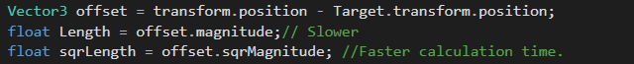

Magnitude Vs SqrMagnitude
When calculating the distance between two vectors, it is much fast to use (sqrmagnitude)
This is because calculating the square root takes longer to execute than normal arithmetic operations so calculating the squared magnitude is much faster.
Using the example above you can find out how close an object is to the player.
Target
SqrMagnitude = 25
Magnitude = $\sqrt{25}=5$
Player
This takes time.
Notes:
Another example is finding which car is in 1st place based on the distance to the end.

Slide 33
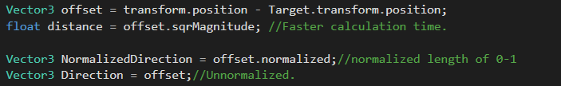
Normalising Vectors
Normalizing a vector keeps the same direction but its length is 1.0.
Player
Target
Target
(-1.0, 0, 0)
(-8.4, 0, 0)
Normalized
Unnormalized

Slide 34
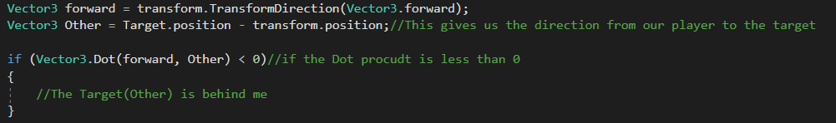
Dot Product
The dot product is a float value equal to the magnitudes of the two vectors multiplied together and then multiplied by the cosine of the angle between them.
Using the Dot Product we can find out if objects are in front or behind the player or within an angle of the players forward vector.
E.g. A turret aiming at a target if they get within the turrets cone of vision the Dot Product will return a value between -1 – 1. This value corresponds to the angle.
0.52 = 65˚ or -0.52 = 130˚
0.84
1
0.84
If the enemy is within the cone of vision we can attack. E.g if the DotProduct value is between 0.84 and 1.
Another visual example: Here
0
Turret
0
-1
Notes:
void Update ()
{
Vector3 forward = transform.TransformDirection(Vector3.forward);
Vector3 Other = Target.position - transform.position;//This gives us the direction from our player to the target
if (Vector3.Dot(forward, Other) < 0)//if the Dot procudt is less than 0
{
//The Target(Other) is behind me
}
}

Slide 35
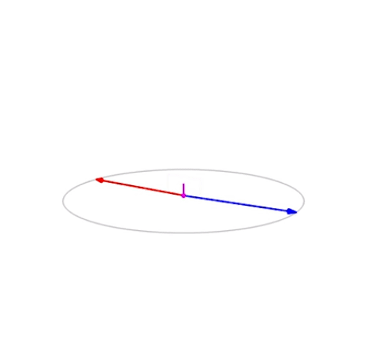
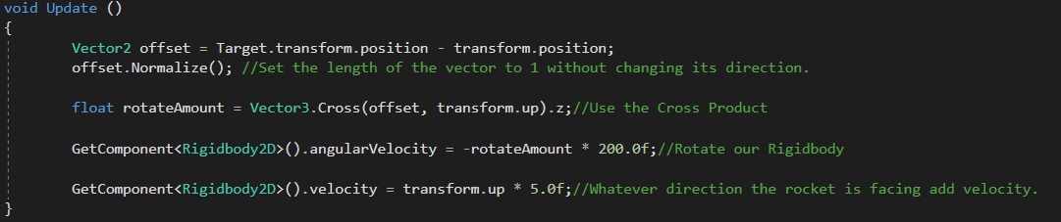
Cross Product
The Cross product will give us a 3rd vector perpendicular to the 2 vectors given. The result's magnitude is equal to the magnitudes of the two inputs multiplied together and then multiplied by the sine of the angle between the inputs.
Imagine we have a Homing Missile and a Target, we want our Missile to rotate and aim at the target.
Target
Missile
Direction
Forward x target
Notes:
void Update ()
{
Vector2 offset = Target.transform.position - transform.position;
offset.Normalize(); //Set the length of the vector to 1 without changing its direction.
float rotateAmount = Vector3.Cross(offset, transform.up).z;//Using the Cross Product change the
GetComponent<Rigidbody2D>().angularVelocity = -rotateAmount * 200.0f;//Rotate our Rigidbody
GetComponent<Rigidbody2D>().velocity = transform.up * 5.0f;//Whatever direction the rocket is facing add velocity.
}

Slide 36
Enabling and disabling
It is possible to enable and disable GameObjects.
You can do this in the Inspector by clicking on the checkbox next the a GameObject’s name.
You can also change this checkbox dynamically at runtime with script.
someGameObject.SetActive(false);
When you disable a GameObject, all of its components are disabled.
This means it will disappear form the scene as its renderer will be switched off.
It will also disable colliders, rigidbodies and any scripts.
This means that no Update methods on any components are called by the engine.
If you deactivate a parent GameObject then this will deactivate all child GameObjects.
Note that the child GameObjects checkbox will still be set to active.
Also note that there are some additional rules for co-routines (another day).

Slide 37
Summary
With your new-found knowledge, take another look at the gameplay examples for the Tilting Board.
See if you can understand how they work.
Now, have a look at the more complex colour-coded door example.
With what you currently know, what else could you try to create with the basic Tilting Board?

